Slide 1
Spring Cleaning Your Computer
Windows Computers.
Jere Minich
Program Director
Lake-Sumter Computer Society
Leesburg, FL
APCUG Board of Advisors
Region 5 - Florida
Copies of this presentation have been sent to your CUG

Slide 2

Happy.???
This Presentation covers Windows Vista, Windows 7 & 8.

Slide 3
Overview of Spring Cleaning
Why do I need to perform Maintenance.
What to do about a spill on my PC.
Windows Maintenance Tasks.
Programs that tidy up your computer.
How to Disable Programs that slow your PC.
Updating Applications and Security Tools.
How to run Disk Cleanup.
User Accounts –Protection
Note: some slides will appear only briefly.

Slide 4
PC Maintenance – Why?
A complex, small, digital device needs TLC.
Because your digital device is an investment.
To keep it in good operating condition.
Will help your PC run faster.
Use resources more efficiently. (Memory, RAM)
Save you from headaches caused by system failures and degradation.
Most importantly, proper maintenance is crucial in order to protect your digital device from security threats such as:
  worms,
  viruses
  and other malicious activity. (Malware)

Slide 5
Perform the following with PC Off:
Unplugged – Desk Top
  Remove the Battery - Laptop
1. Clean the Monitor screen w/ liquid sprayed on cloth.
  Eye Glasses spray is perfect
  Microfiber cloths are excellent for this purpose
2. Vacuum around exhaust ports w/ round brush attachment. (Do Not Blow Air into PC)
3. Clean Mouse & Keyboard with Handy Wipe.
4. Run a cotton swab dipped in rubbing alcohol around all of the openings on the outside of your case.
  one swipe with the damp end.
  one swipe with the dry end.

Slide 6
If a Spill Happens on Keyboard
Immediately:
Turn off your computer –
a. Explain “Emergency Shut Down” procedure.
Disconnect the keyboard and flip it over:
a. Keyboard Cord is thicker than mouse cord.
While the keyboard is upside down:
  blot the keys with a paper towel
  leave it to ‘air dry’ overnight
Ensure that all traces of moisture have evaporated before using the keyboard again.

Slide 7
Extra Info-
If your Cell Phone Gets Wet
Hint: Don’t Panic
Do not shake it – that spreads liquid.
  Turn it off.
  Remove the battery
  Wipe off all liquid with dry cloth
  Put it in a zip-lock bag with dry white rice.
    Uncooked dry white rice.
  Let it set overnight – minimum.

Slide 8
Spring Cleaning Tasks
Maintenance tasks that will help clean up your PC’s digital clutter.
1. Set a System Restore point – when PC is Healthy – Know How.
a. The System Restore :
    allows users to restore their computers to a previous state without losing personal data files.
b. so if a problem occurs on your PC, you can reset Windows to a previous date of good functional state.
Note that ‘System Restore’ will NOT delete files such as:
  Photos
  documents,
It will purge programs that you installed and the settings you changed between now and the restore point you return to.
Note: Not all software gets along with other software already on your computer.= download new software = S/W fight.

Slide 9
To initiate a restore point in Vista:
(Perform at home when PC is Healthy)
a. Click the Start button,
b. Select ‘Control Panel’,
c. Select ‘System And Maintenance’.
d. Click ‘Restore Files From Backup’,
e. Select ‘Create A Restore Point’ or ‘Change Settings’,
f. Click the ‘Create’ button.

Slide 10
To set a Restore Point in Windows 7.
1. click the Start button ,
2. In the Search bar, Type –”Restore”
3. Choose ‘Backup and Restore’
4. Near the bottom of the window: click ‘Recover System Setting on your Computer’.
5. Click – ‘Open System Restore’ button.
6. Click the ‘Next’ button
7. Select a Restore date.
Follow the process thru.

Slide 11
To set a Restore Point in Windows 8
(Perform at home when PC is Healthy)
1. Press the Windows ‘logo’ key + W to open the Settings menu.
2. Type ‘restore’ in the search field.
3. In the search results, click ‘Create a Restore Point’ .
  The “System Properties’ window opens.
4. Click the ‘Create’ button.
5. Type a descriptive name for the restore point that will help you remember when you created the restore point.
6. Click Create .
  The computer creates the restore point.
7. When the restore point is created, a small window appears stating that the restore point was created successfully.
8. Click Close
9. Click OK to close the system restore window.

Slide 12
Spring Cleaning Tasks
2. Tidy Up Your Computer (frequently)
CCleaner is a freeware system optimization, privacy and cleaning tool. NOT Aggressive
It Cleans:
  Internet Explorer, Firefox, Google Chrome, Browsers.
  Windows - Recycle Bin, Recent Documents, Temporary files and Log files.
  Registry cleaner – run separately.
Go To: www.filehippo.com and download ‘CCleaner’
  good trusted site for cCleaner
  allows bypass to ‘Free downloads’ w/o hassle.
  Downloading a program should be a 2 step process.
      Download with ‘Save’ – not ‘Run’
      Install after download is complete

Slide 13
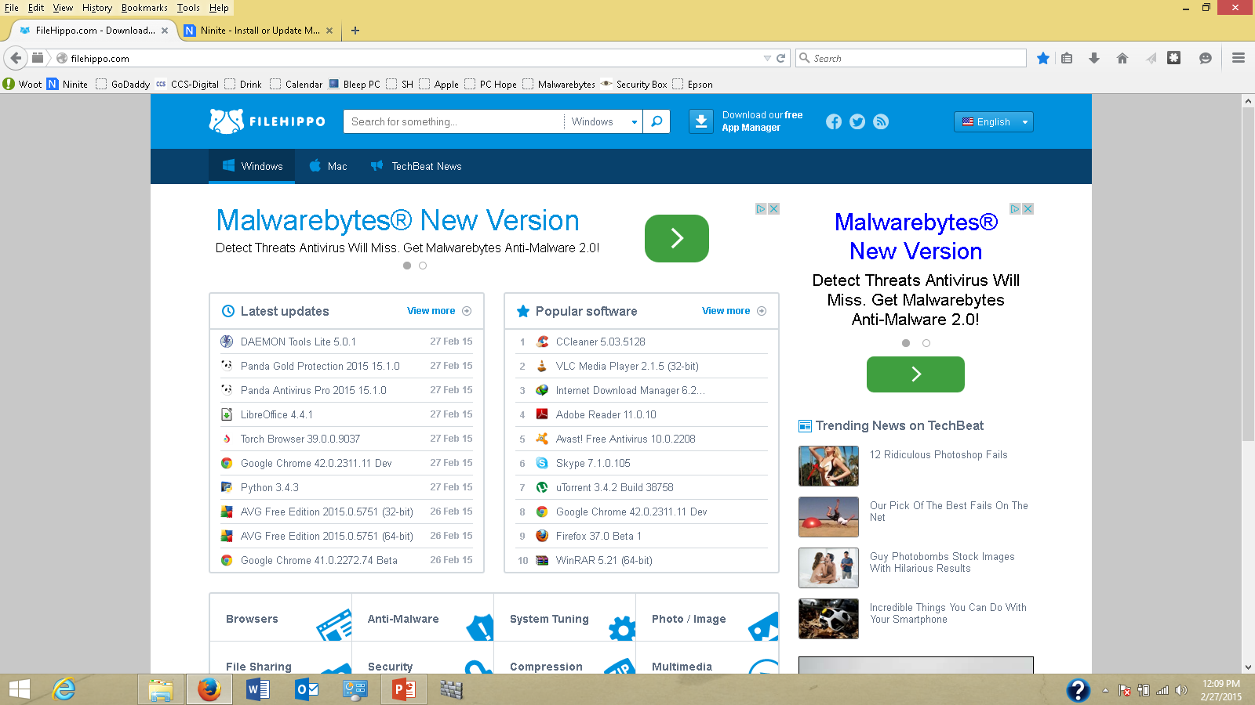
CCleaner

Slide 14
‘CCleaner’ removes
- Temporary File Cache - A file created by an application for its own purposes
- URL History – address bar in your browser.
- Cookies - a small piece of data sent from a website
- Hidden Index.dat files - a database file used by the IE, to improve performance.
- Last download file location
-Recycle Bin
-Clipboard- a software space used for short-term storage
  and/or data transfer between documents or applications,
  via cut, copy and paste operations.
-Windows Temporary files
-Windows Log files - a list of events, which have been "logged" by a computer.
-Recent Documents (on the Start Menu)
-Run history (on the Start Menu)
-Windows memory dumps after crashes
-Chkdsk file fragments – (check disk)

Slide 15
3. Clean Up Your Startup Folder
Common Problem - your PC takes longer to start up
Applications and programs are designed to:
  automatically insert themselves into Windows’ startup sequence
  so the application is ready instantly.
  This action:
    drains your system resources
      Slows down a program speed
      Ram is filled up – (Random Access Memory)
  Results in slow startup.

Slide 16
Two Approaches to disable Startup Programs
# 1 - Windows Vista and 7
1.On the Keyboard - Depress: Windows Logo key + R
a. select the ‘run command’ option.
2. Type in the Open box : MSCONFIG
a. Microsoft Configuration Utility
3. Click ‘OK’
3. Select the: ‘Startup’ tab.
4. Select & disable un-necessary programs.
5. Restart PC.

Slide 17
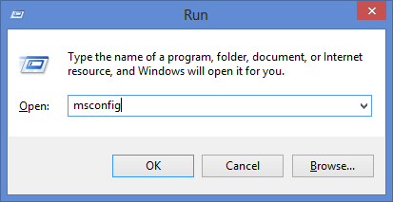
1. ‘Run Command’ Application

Slide 18
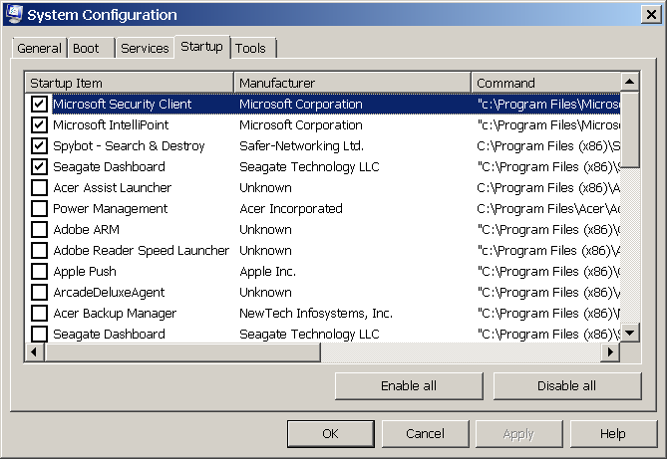
MSConfig – Win Vista, 7
Check marks means still running in the background

Slide 19
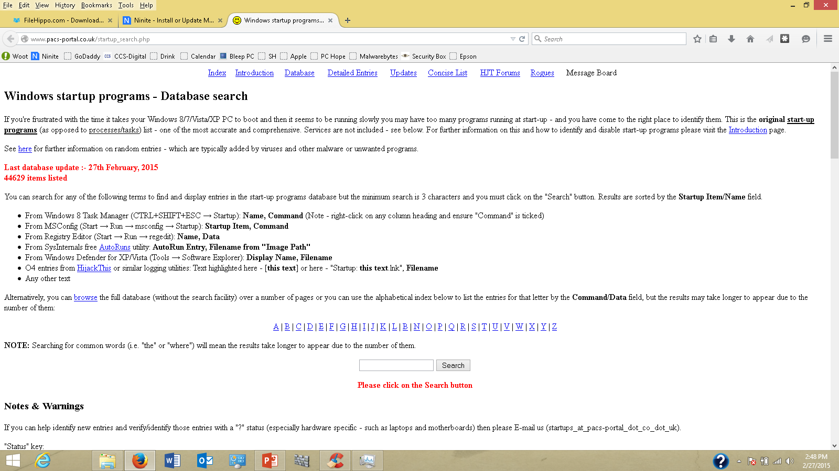
http://www.pacs-portal.co.uk/startup_search.php
Web page Sample

Slide 20
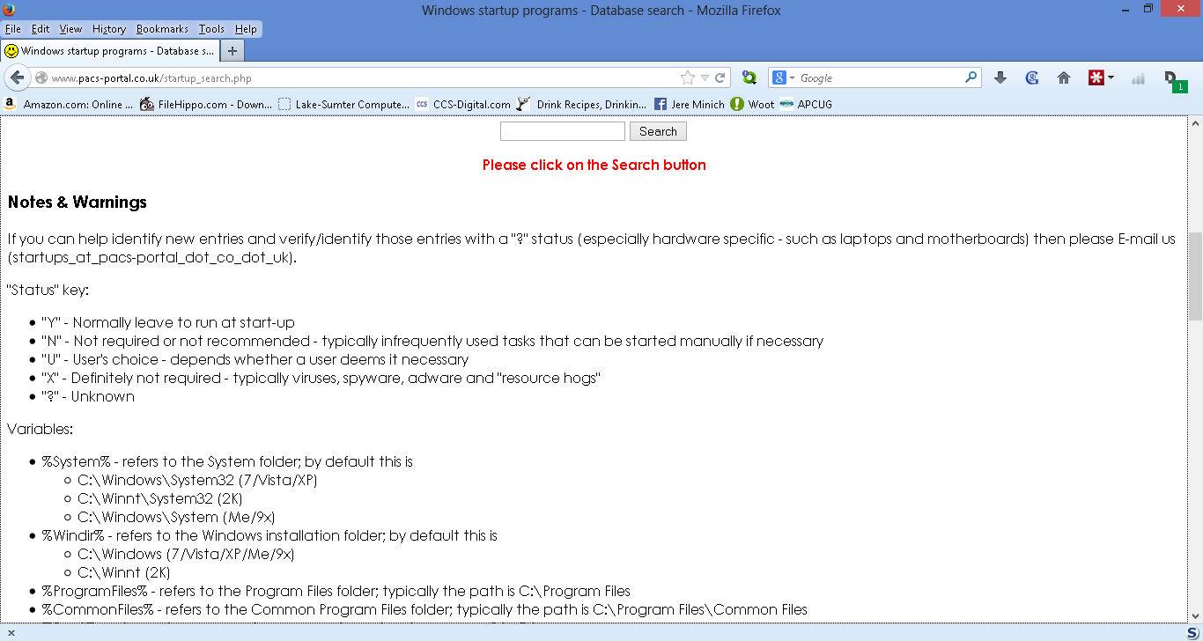
Enter- ‘something.exe’
Search Box

Slide 21
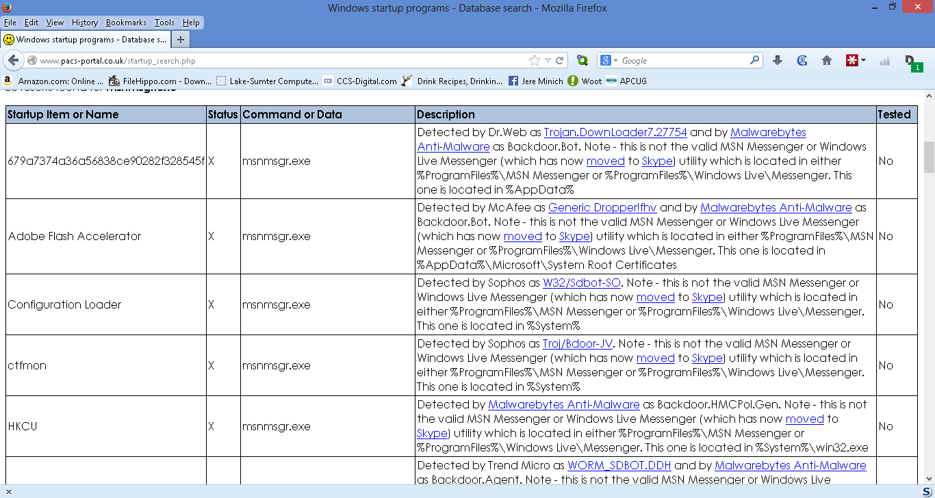
Sample – msnmsgr.exe
"X" - Definitely not required - typically viruses, spyware, adware and "resource hogs"

Slide 22
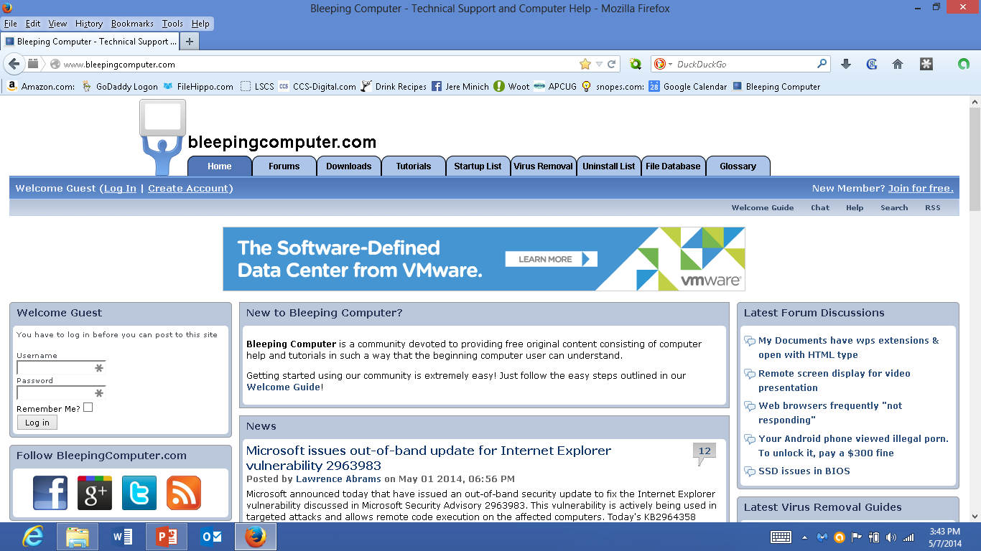
#2. www.bleepingcomputer.com home page
Start Up Tab
‘Startup’ Tab

Slide 23
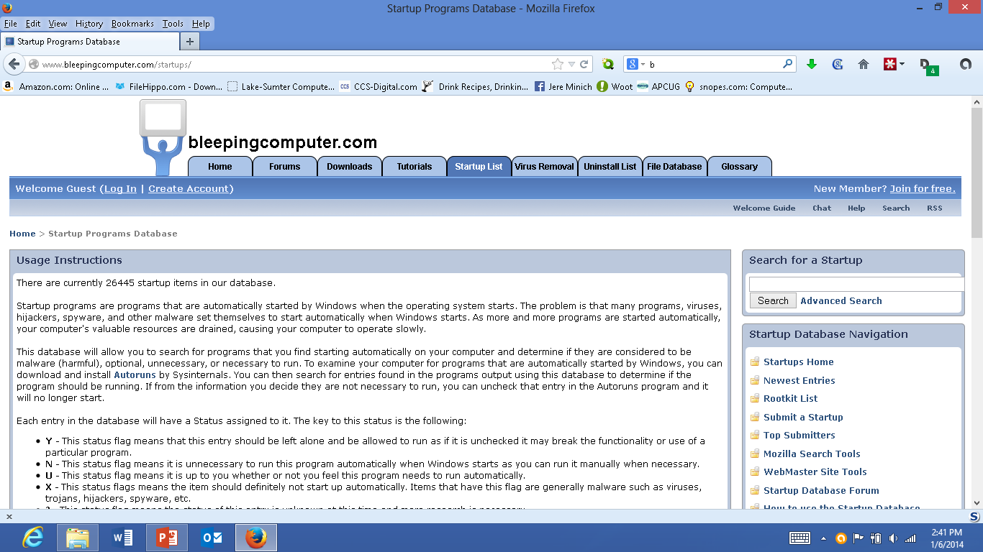
‘Startup List’ tab
@ bleeping computer.com
Click here
Startup Lists
Search here

Slide 24
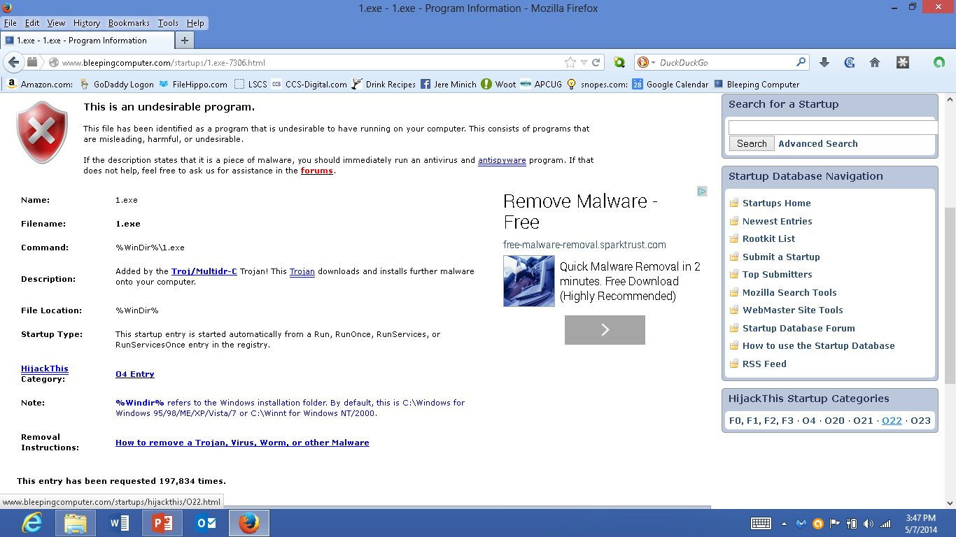
Click on an Item and get a plain language description.

Slide 25
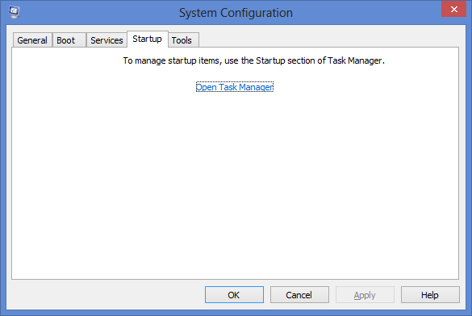
System Configuration Screen –
Windows 8 ( msconfig)
Do NOT Use
Note: To open the task manager =
go to the ‘task bar’;
‘right’ click; select ‘Task Manager’;
Select ‘Startup’ tab.

Slide 26
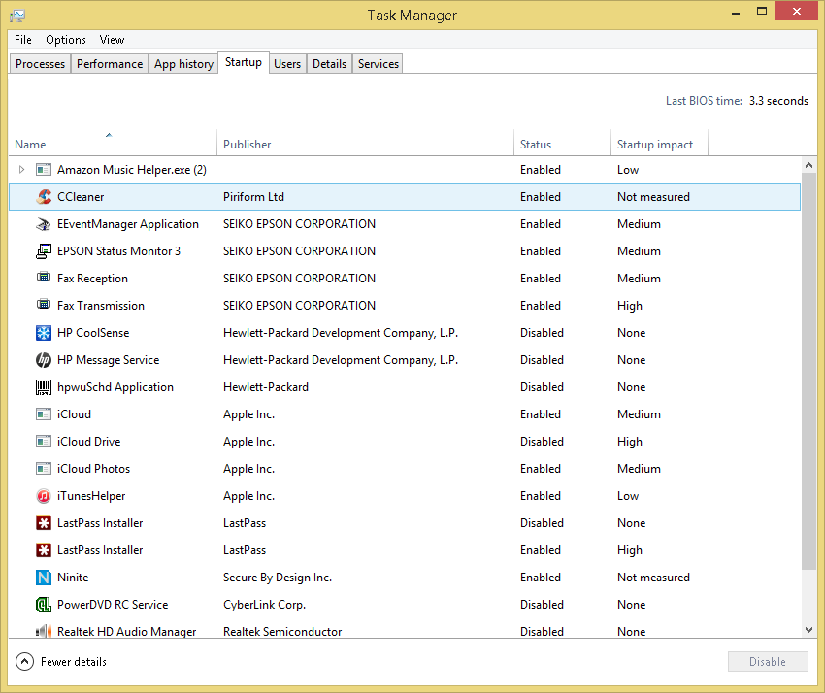
Windows 8 Startup
Startup Tab

Slide 27
4. Update Your Applications (Monthly)
To improve security and functionality, most programs:
  offer an "update" feature from the manufacturer.
  can be configured to check for updates each time you open the program.

Slide 28
How to Update Programs on your PC.
List the applications you regularly use, once a month:
  open the applications,
  select the update feature,
  and allow the application to update itself.
If an application doesn’t offer an integrated update option.
  visit the manufacturer’s Web site and look for the Support or Downloads section.
  Then, search for the updates or patches that are compatible with your application.

Slide 29
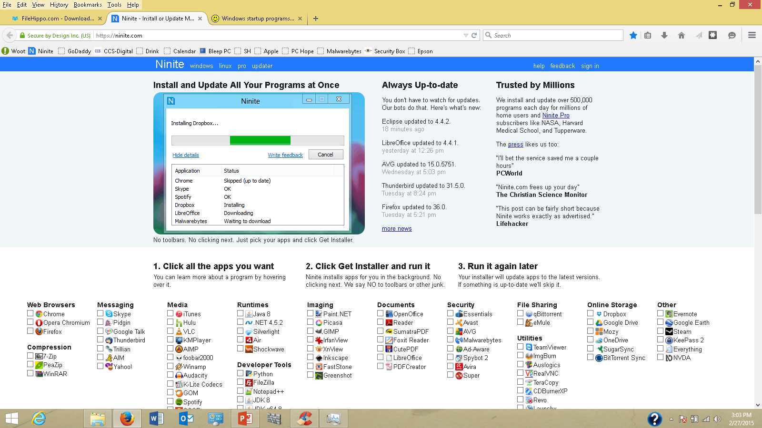
https://www.ninite.com
Download programs and get a Program Update Checker
Secure Site

Slide 30
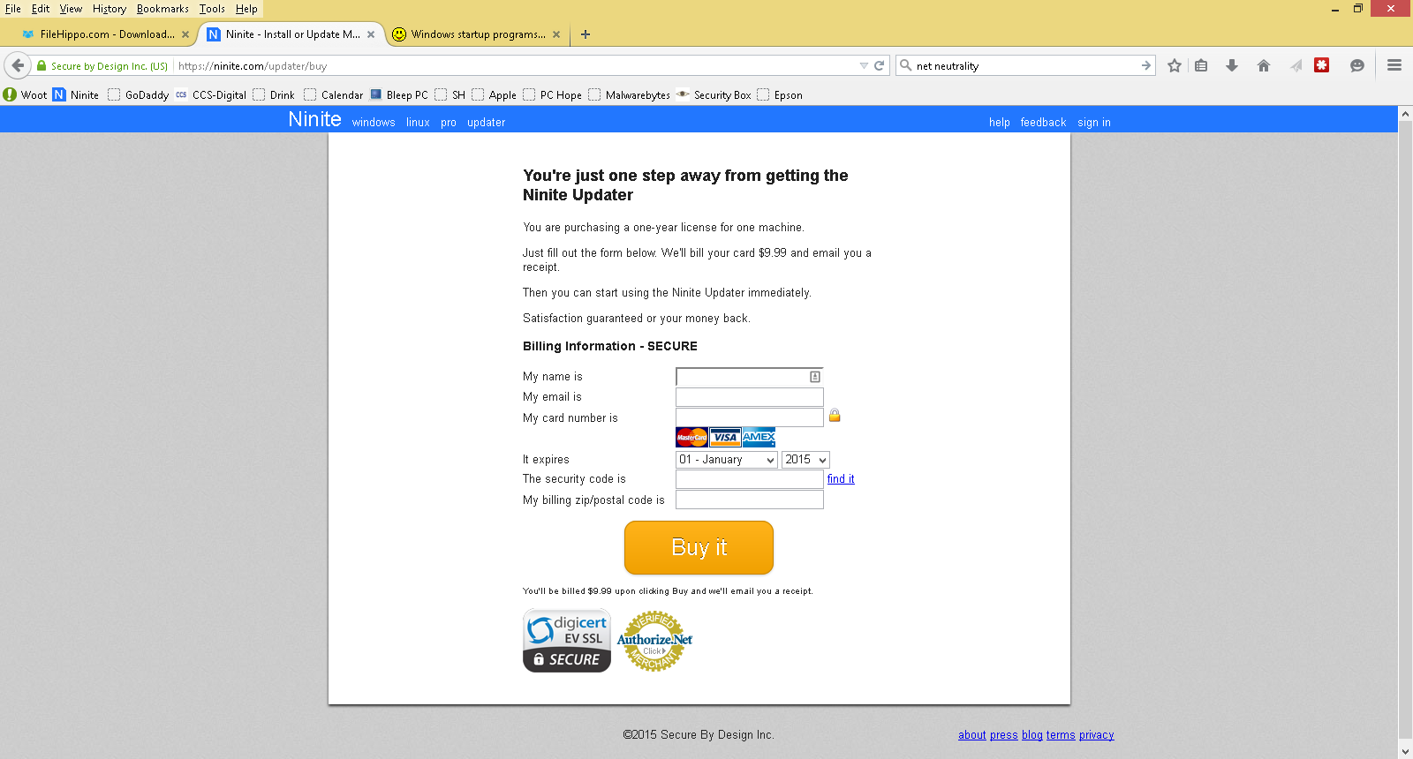

Slide 31
5. Windows Updates.
Vista, Windows 7
Go to the Control Panel
Select Windows Update
Select “Important Updates”
4. Read and Investigate Updates
  Important, Recommended, Optional, Featured .
5. Google your Questions – use KB number: Ex: KB2310138
– I do not know what the Update means.??
6. Install necessary Updates – follow directions.
Automatic Updates – takes control of your PC.
I recommend - use: another option

Slide 32
Turn OFF Automatic Updates:
Microsoft reissued 12 botched security patches in September (that's no exaggeration).
  It's not unusual for Microsoft to release flawed updates, but this past month was over the top, as reported in a recent InfoWorld story.
But most Computer User Groups members are savvy enough to control their own update destiny.

Slide 33
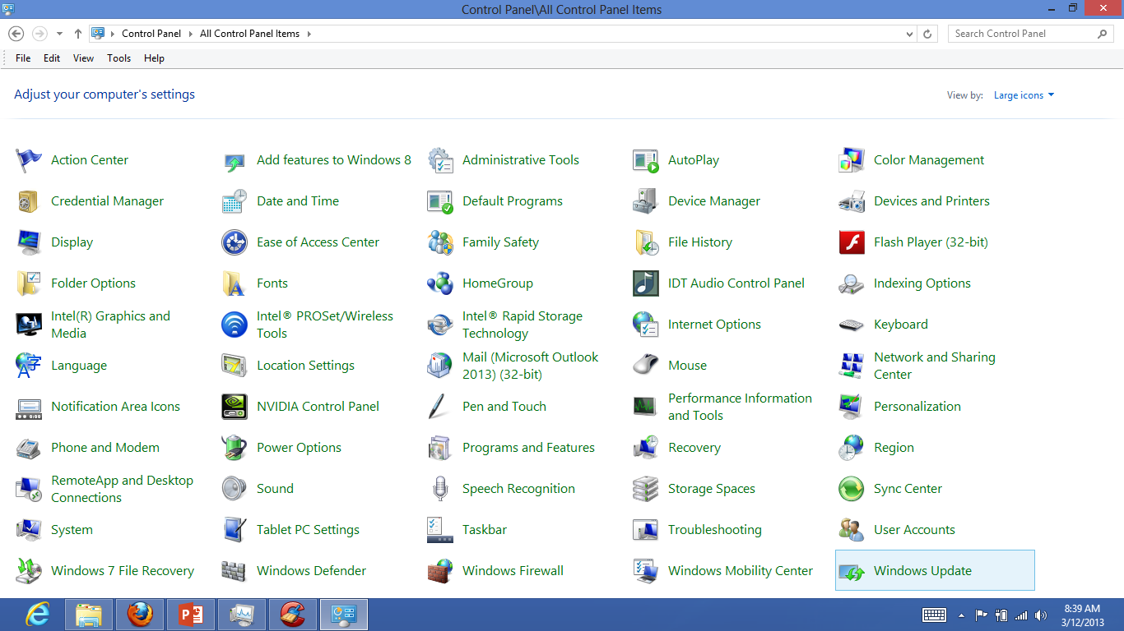
Control Panel – large Icons
Windows Update
Click

Slide 34
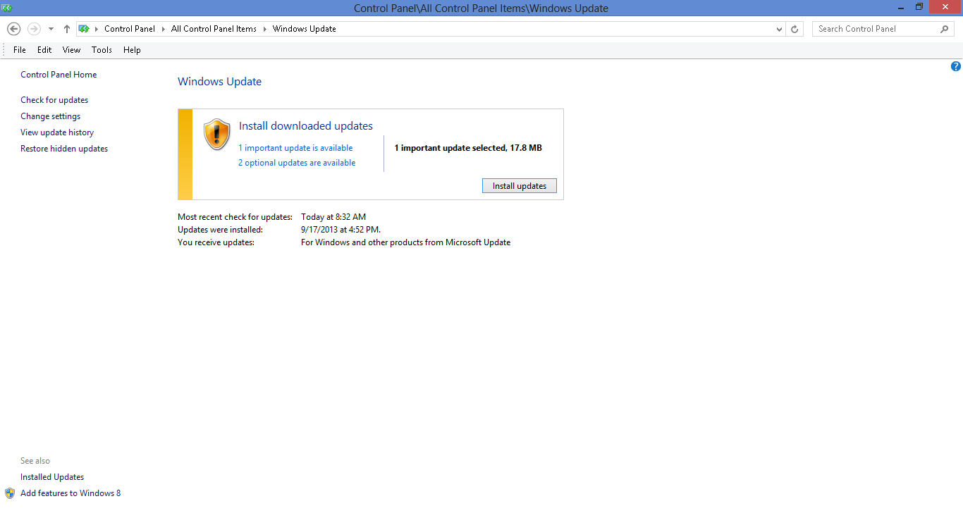
Display of Windows Update
Automatic Updates Not selected.
Click here to investigate

Slide 35
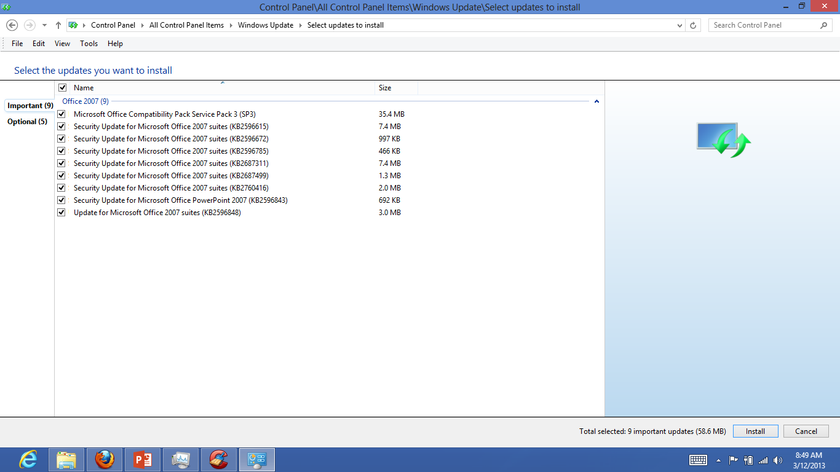
Select Updates to Install
. Google your Questions – use KB number: Ex: KB2310138
Minimize “Windows Update” window during download and install process.

Slide 36
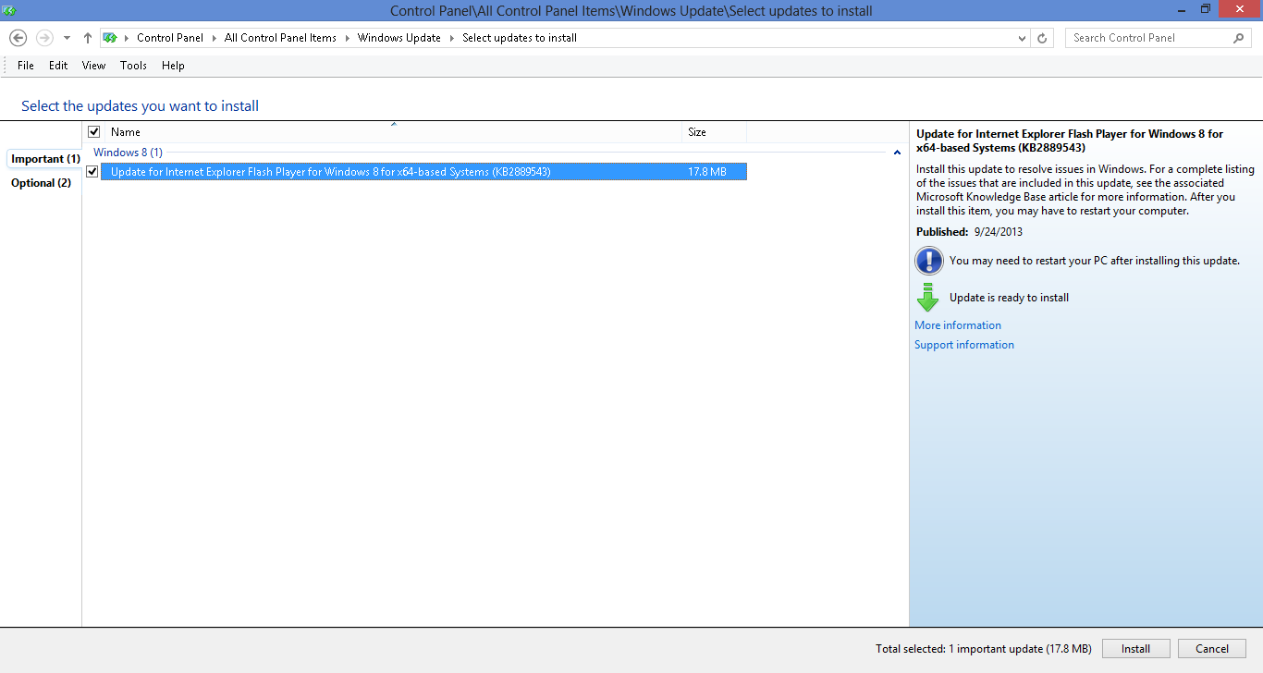
Important Updates
KB Number
Standard Explanation
More Information; Support Information

Slide 37
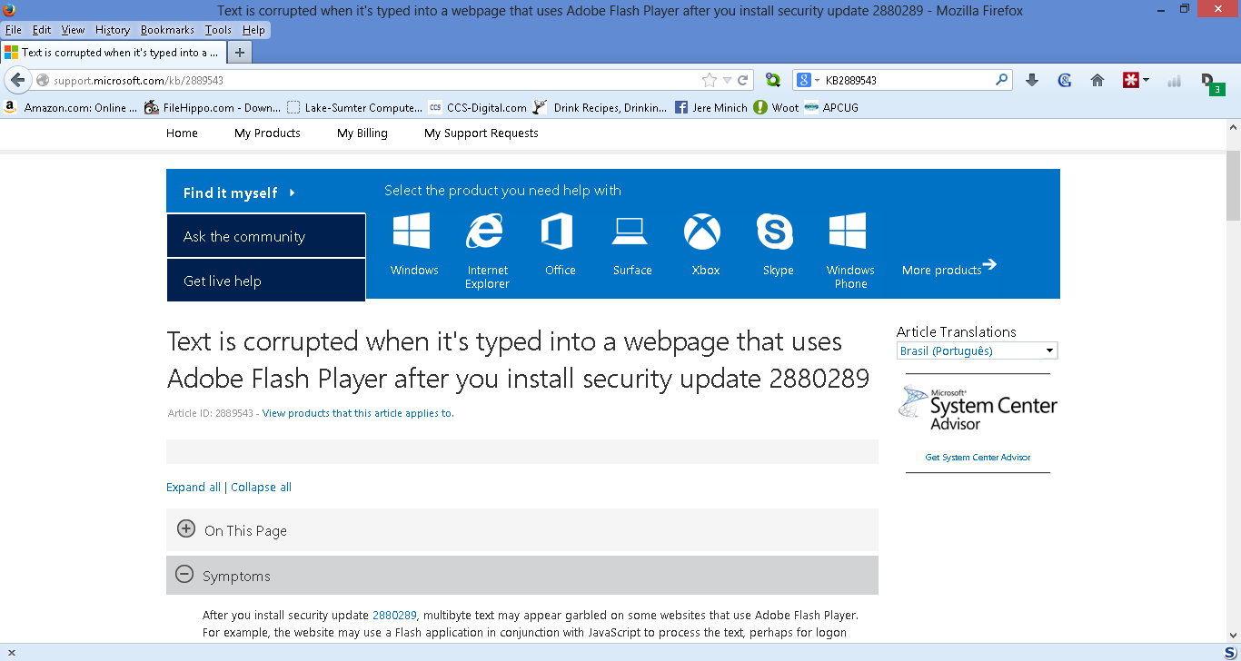
KB2889543 Web page
This is a Windows Update that corrects a previous Update.

Slide 38
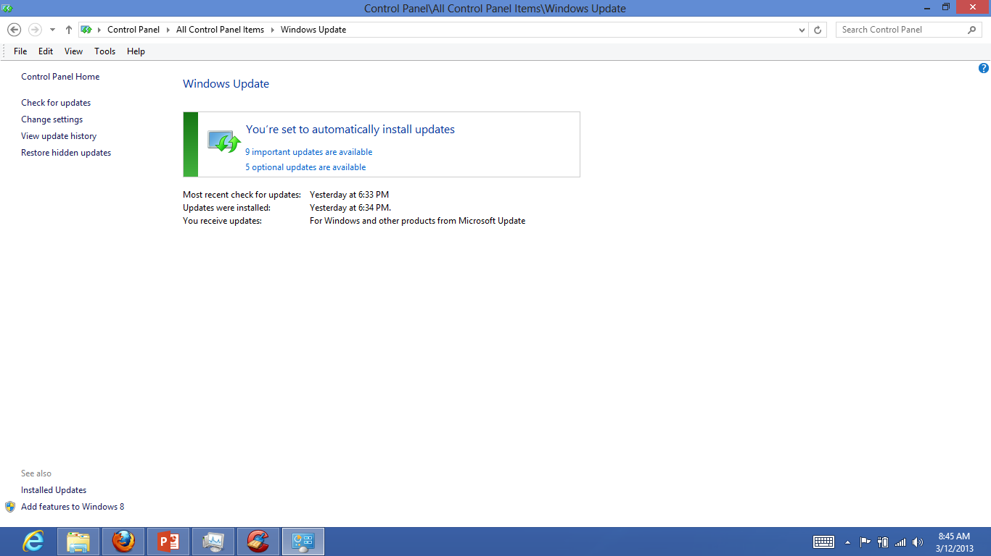
Control Panel – Windows Updates
Change Settings
Click

Slide 39
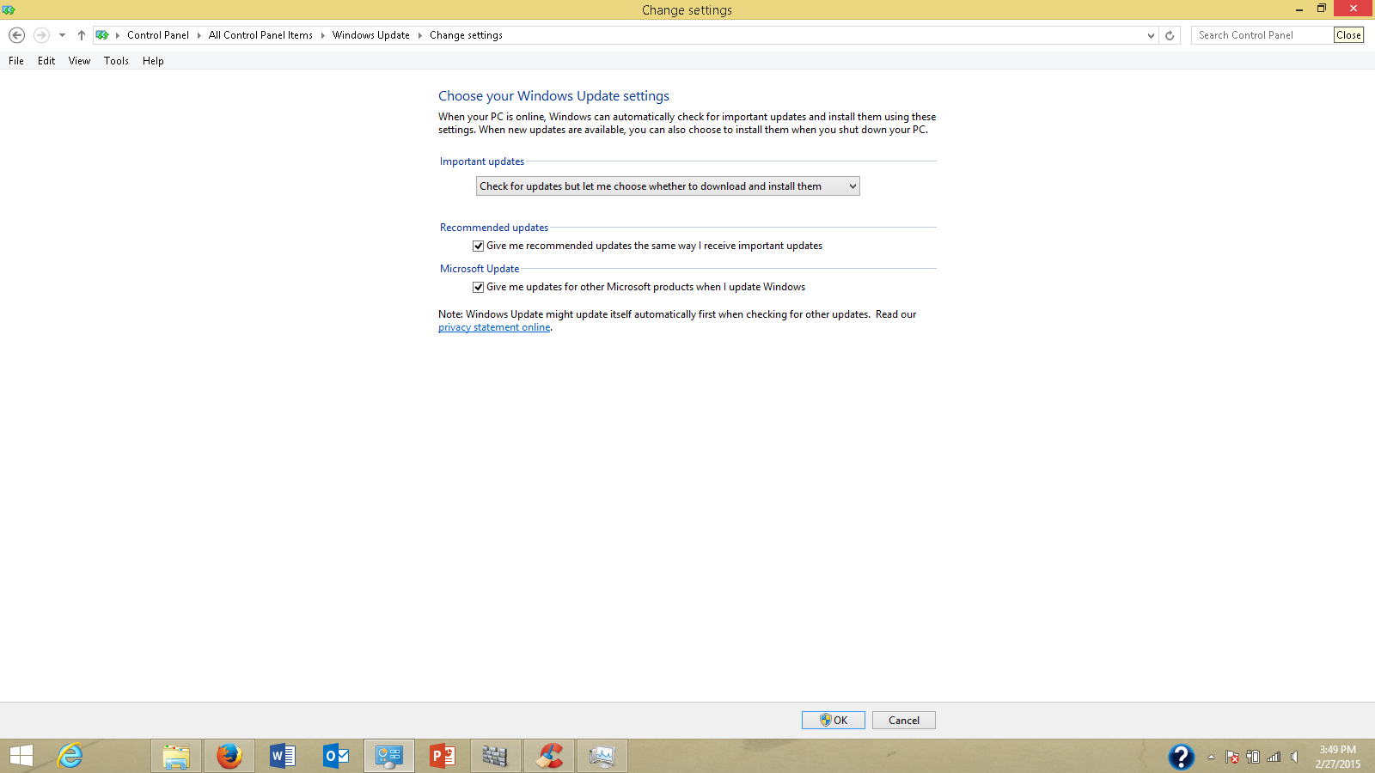
Windows Update - Change Settings check for updates but let me choose whether to download and install them
Click here

Slide 40
6. Maintain Your Hard Drive (weekly)
Applications sometimes create temporary files that are no longer necessary.
  These “junk” files fill up your hard drive,
  Hard Drive get fragmented.
  It takes longer for your computer to open files and perform security scans.
Windows “Disk Cleanup” utility
  designed to locate and remove the unnecessary files and free up storage space on your PC.
  cCleaner does not clean up everything.

Slide 41
‘Disk Cleanup’ removes: the Microsoft cleanup tool
temporary Internet files.
downloaded program files.
  For example, ActiveX controls and Java applets that are downloaded from the Internet.
Windows temporary files.
Optional Windows components that you are not using.
Installed programs that you no longer use.
Empties the Recycle Bin.
Windows Updates that are no longer required.
  delete previous Windows installations, Windows Defender files, and Windows upgrade log files that you might no longer need.

Slide 42
To open Disk Cleanup:
Vista, Win 7
1. Click the Start button,
2. All Programs,
3. Accessories,
4. System Tools,
5. Disk Cleanup.

Slide 43
Disk Cleanup via Search Charm
Windows 8
Open the Charms bar
Click on Search.
Type in ‘Disk Cleanup’
Click on Settings.
5. Click on ‘Free up disk space by deleting unnecessary files” button.
This will bring up Disk Cleanup.
6. Click on ‘Cleanup System Files’ button.

Slide 44
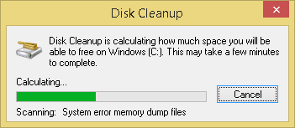
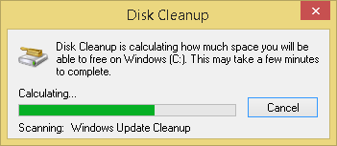
Displays of Disk Cleanup

Slide 45
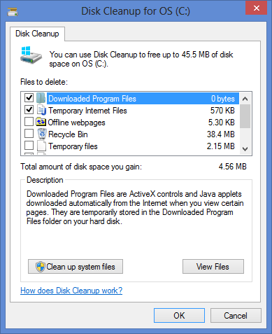
Disk Cleanup
Make Sure all Boxes are checked
Describes Selected Item

Slide 46
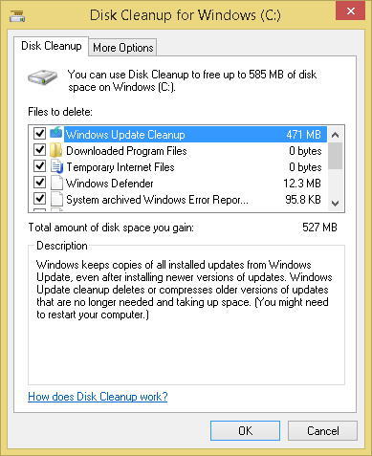
Second Display
All Boxes Checked
Click on this Button

Slide 47
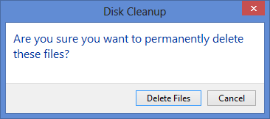
Double Check Dialog Box
Click Here

Slide 48
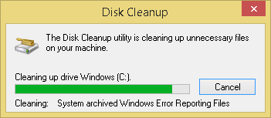
Disk Cleanup Last display
It is best to “Restart” your PC after Disk Cleanup.

Slide 49
7. Update all Security Tools
Free versus Paid Anti-virus - Depending on whom you ask, paying for antivirus software is either a:
  good investment
  or a total ripoff.
In reality, neither viewpoint is accurate.
You can find plenty of good reasons to choose a paid antivirus product, and plenty of good reasons to go with a freebie.

Slide 50
Free Anti-virus with Microsoft
Microsoft Security Essentials - Built into Vista and Win 7
Win 8 - Anti-Virus is called “Windows Defender”
    It is in fact “Microsoft Security Essentials”
  to prevent spyware,
  Windows includes a few security tools that you’ll want to keep up-to-date to protect your PC from malware threats.

Slide 51
What is a Malware Cycle
Using malware-infected computers to make money is easier and safer than any other illegal endeavor.
Hacker makes a Malware program/ puts it on the Internet.
Antivirus company discovers malware/makes a fix.
You get an update to your antivirus software.
You install the update.
What is the time lapse between steps
1 and 4.?
No Anti-virus is 100% effective.

Slide 52
8. Delete Programs
Get rid of Programs you no longer need or use.
Uninstall a program from your computer if:
  you no longer use it
You can use “Programs and Features” to: (from the Control Panel)
  uninstall programs
  change the program's configuration by adding or removing certain options.
  repair the program
Windows 7 or 8 =
1. Go to the ‘Control Panel’
2. Click ‘Programs and Features.’
3. Select a program, and then click Uninstall.
  To change a program, click ‘Change’ or ‘Repair’.

Slide 53
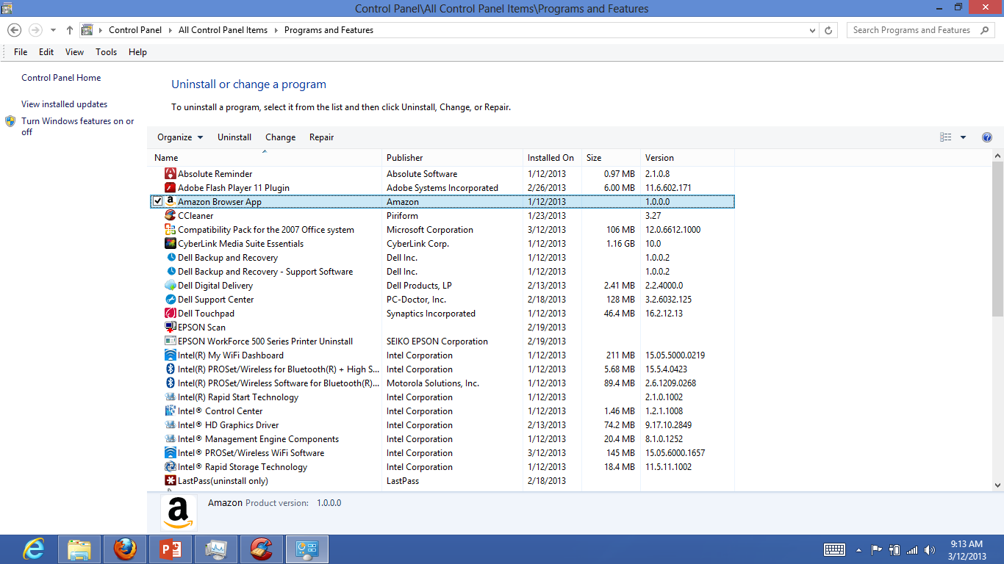
‘Programs and Features’
Control Panel

Slide 54
Revo-uninstaller or IObit Uninstaller 2.0
Google: Revouninstaller Free - Also available in ninite
Launching either fires up the Uninstaller screen:
  which shows icons and titles of all programs installed on your machine.
4 Step Process
1. Set restore Point
2. Run Uninstall
3. Search for left over Registry Items.
4. Search for left over Files on Hard Drive.

Slide 55
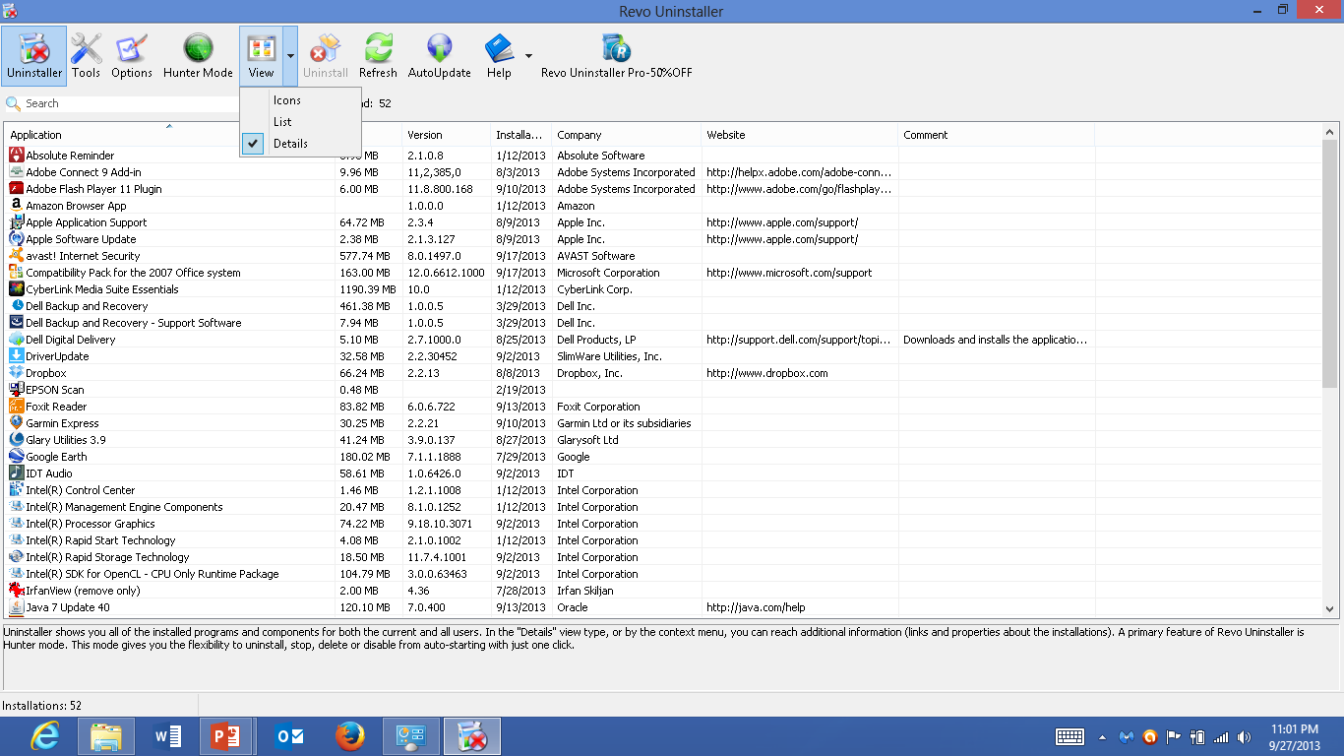
Revo –View Selection

Slide 56
9. Help and Support – Your Computer Book.
Open Help and Support – and read contents: Search For;
1. ‘Anti-virus’
2. ‘Windows Defender’
3. ‘Firewall’
4. ‘Disk Cleanup’
5. ‘Startup’
6. Which user account is right for me?
  Microsoft suggests Standard Account

Slide 57
10. Don't stay logged on as an administrator – Microsoft words
Why use a standard user account instead of an administrator account?
When you are using programs that require Internet access, such as:
  a web browser
  an e‑mail program,
we recommend that you log on as a standard user rather than an administrator.
That's because many viruses and worms can't be stored and run on your computer unless you're logged on as an administrator.

Slide 58
Users at Home
On Your Home Computer: ‘Security Companies recommend’
  Create a password for all computers (Desktop or Laptop).
  You must have a Administrative Account with a hard Password.
  Create a Standard Account with Hard Password.
    Use that to Login every day.
  Have a Guest Account for Grandchildren & other guests, with a simple password.

Slide 59
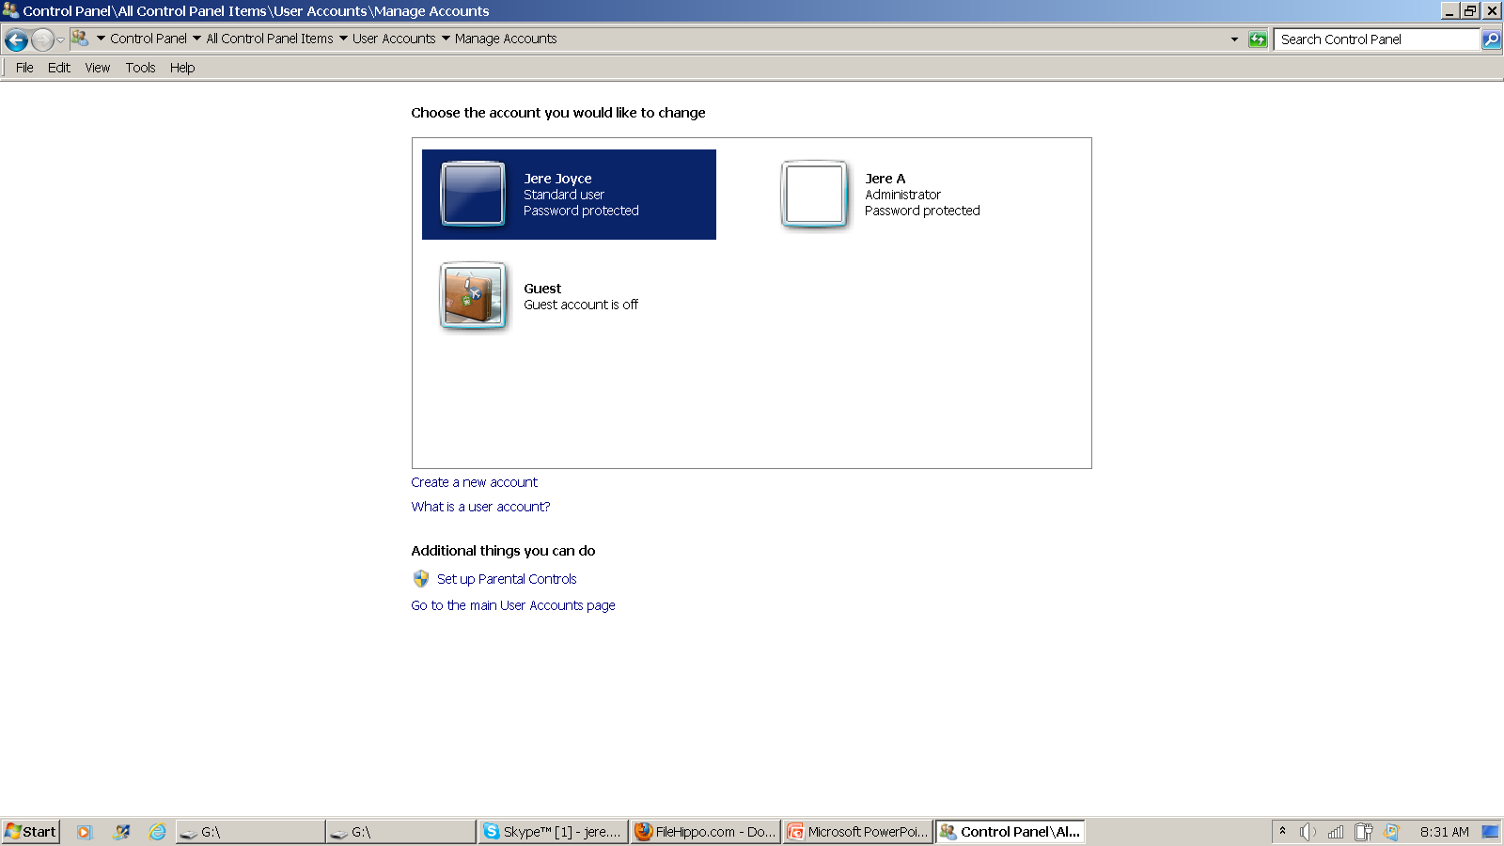
Manage Accounts in Control Panel
Sign in each days as ‘Standard’ account, NOT as ‘Administrator’

Slide 60
User Accounts
Note: You can not delete the account for a user that is currently logged on to the computer.
The standard account can help protect your computer
Always login using a Standard Account- never as “Administrator”
  If you are hacked while on the internet:
    The hacker has limited capabilities..
    Windows will ask you to provide a password for an administrator account.

Slide 61
Spring Clean Your Computer Review.
1. Regular Maintenance keeps your computer running at top performance.
2. Restore Points are sometimes very beneficial.
3. Disk Cleanup is a monthly function.
4. Keep your programs & Anti-Virus updated.
5. www.ninite.com is a trusted Web Site.
6. Log on to your PC as a Standard user.
7. Got a Question, go to your PC book- Help and Support

Slide 62
Spring Clean Your Computer
Things to do when your computer is Healthy:
    A. Set a restore point.
    B. Clean out your start-up File.
    C. Download and Run ‘Ccleaner’ at least weekly.
    D. Update your Applications.
    E. Perform ‘Disk Cleanup’.
    F. Run Updates on your Anti-Virus program

Slide 63
Final Word
You have a question: email me at:
    Jere Minich
    jminich@apcug.org

Slide 64

The End…..

